Slide 1
Routing Concepts
Prepared by
Risala Tasin Khan
Professor
IIT, JU

Slide 2
Router as a Computer
Routers are
Computers that specialize in sending packets over the data network
They are responsible for interconnecting networks by selecting the best path for a packet to travel and forwarding packets to their destination
Routers are the network center
Routers generally have 2 connections:
WAN connection (Connection to ISP)
LAN connection

Slide 3
General Role of the Router
Connections of a Router for WAN
A router has a DB-60 port that can support 5 different cabling standards
Connections of a Router for Ethernet
2 types of connectors can be used: Straight through and Cross-over
Straight through used to connect:
Switch-to-Router, Switch-to-PC, Router-to-Server, Hub-to-PC, Hub-to-Server
Cross-over used to connect:
Switch-to-Switch, PC-to-PC, Switch-to-Hub, Hub-to-Hub, Router-to-Router

Slide 4
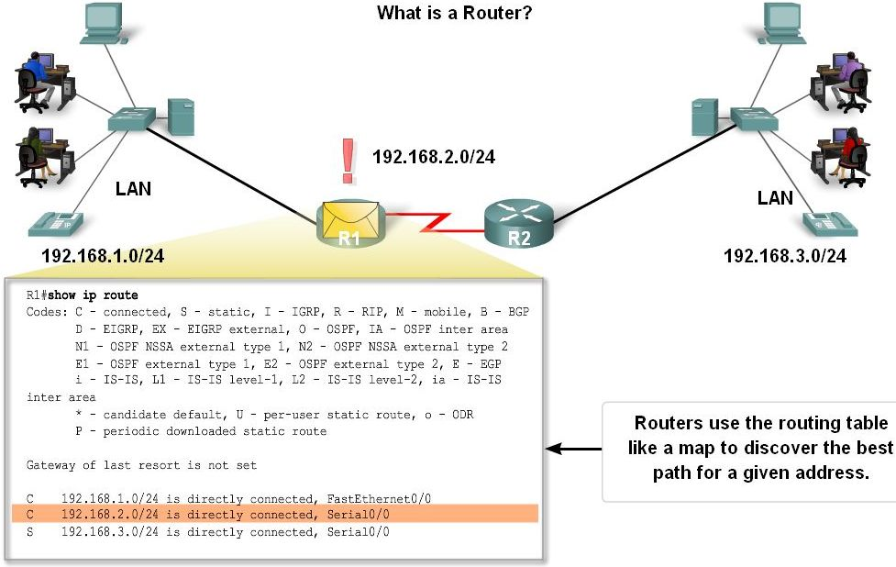
Router as a Computer
Routers examine a packet’s destination IP address and determine the best path by enlisting the aid of a routing table

Slide 5
Router as a Computer
Router components and their functions:
CPU - Executes operating system instructions
Random access memory (RAM) - Contains the running copy of configuration file. Stores routing table. RAM contents lost when power is off.
Read-only memory (ROM) - Holds diagnostic software used when router is powered up. Stores the router’s bootstrap program.
Non-volatile RAM (NVRAM) - Stores startup configuration. This may include IP addresses (Routing protocol, Hostname of router).
Flash memory - Contains the operating system (Cisco IOS).
Interfaces - There exist multiple physical interfaces that are used to connect network. Examples of interface types:
Ethernet / fast Ethernet interfaces
Serial interfaces
Management interfaces

Slide 6
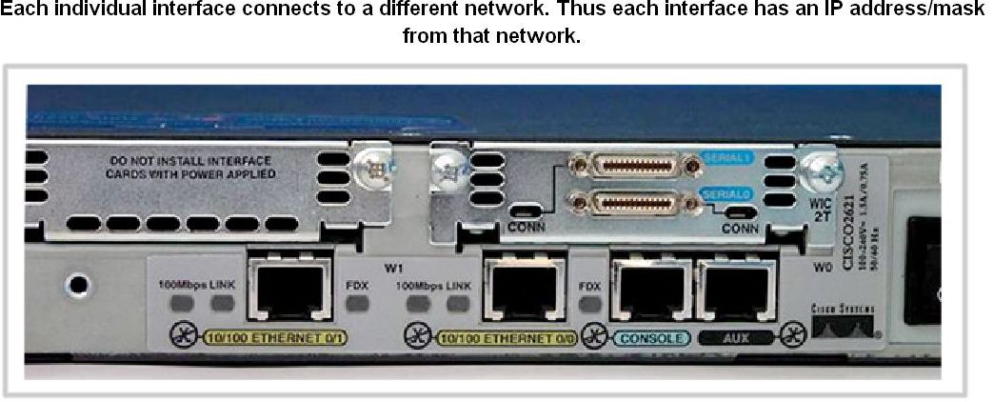
Router as a Computer
Router Interface is a physical connector that enables a router to send or receive packets
Each interface connects to a separate network
Consist of socket or jack found on the outside of a router
Types of router interfaces:
Ethernet
Fastethernet
Serial
DSL
ISDN
Cable

Slide 7
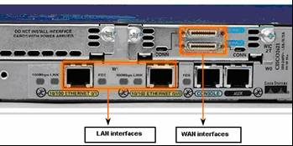
Router as a Computer
Two major groups of Router Interfaces
LAN Interfaces
Are used to connect router to LAN network
Has a layer 2 MAC address
Can be assigned a Layer 3 IP address
Usually consist of an RJ-45 jack
WAN Interfaces
Are used to connect routers to external networks that interconnect LANs
Depending on the WAN technology, a layer 2 address may be used
Uses a layer 3 IP address

Slide 8
Basic Routing
The role of routing protocols is to learn about other networks dynamically, exchange routing information with other devices, and connect internal and/or external networks.
It is important to note that routing protocols DO NOT send packets across the network.
Their role is to determine the best path for routing.
Different routing protocols use different means of determining the best or most optimal path to a network or network node.
Some types of routing protocols work best in static environments or environments with few or no changes, but it might take a long time to converge when changes to those environments are made.
Other routing protocols, however, respond very quickly to changes in the network and can converge rapidly.
Network convergence occurs when all routers in the network have the same view and agree on optimal routes.
When convergence takes a long time to occur, intermittent packet loss and loss of connectivity may be experienced between remote networks.
Notes:
Network convergence refers to the provision of telephone, video and data communication services within a single network. In other words, one company provides services for all forms of communication.

Slide 9
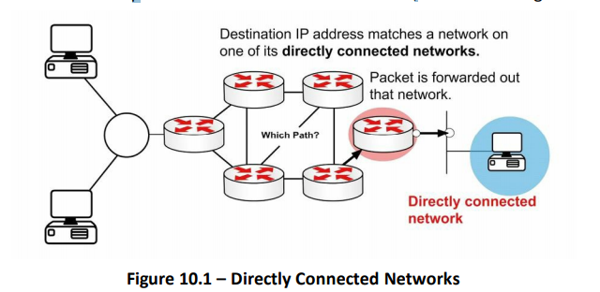
Packet Forwarding
Packet forwarding involves two processes:
Determining the best path
Sending the packet (switching)
When the router receives a packet for a directly connected network, the router checks the routing table and then the packet is forwarded to that network,

Slide 10
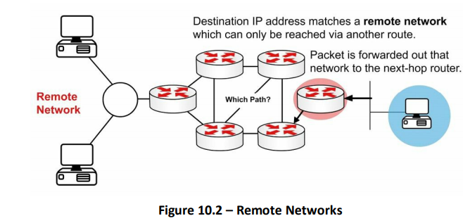
Packet Forwarding (cont..)
If the packet is destined for a remote network, the routing table is checked and if there is a route or default route, the packet is forwarded to the next-hop router as shown in the figure

Slide 11
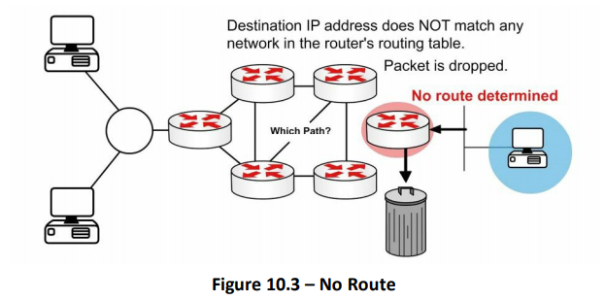
Packet Forwarding (Cont..)
If the packet is destined for a network not in the routing table and no default route exists then it is dropped, as shown in Figure

Slide 12
Internet Protocol Routing Fundamentals
A routing protocol allows a router to learn dynamically how to reach other networks.
A routing protocol also allows the router to exchange learned network information with other routers or hosts.
we can classify routing algorithms is according to whether they are global or decentralized:
A global routing algorithm
computes the least-cost path between a source and destination using complete, global knowledge about the network.
That is, the algorithm takes the connectivity between all nodes and all link costs as inputs.
This then requires that the algorithm somehow obtain this information before actually performing the calculation. The calculation itself can be run at one site (a centralized global routing algorithm) or replicated at multiple sites.
In practice, algorithms with global state information are often referred to as link-state (LS) algorithms, since the algorithm must be aware of the cost of each link in the network.

Slide 13
Cont…
decentralized routing algorithm:
The calculation of the least-cost path is carried out in an iterative, distributed manner.
No node has complete information about the costs of all network links. Instead, each node begins with only the knowledge of the costs of its own directly attached links.
Then, through an iterative process of calculation and exchange of information with its neighboring nodes (that is, nodes that are at the other end of links to which it itself is attached), a node gradually calculates the least-cost path to a destination or set of destinations.
The decentralized routing algorithm is called a distance-vector (DV) algorithm, because each node maintains a vector of estimates of the costs (distances) to all other nodes in the network

Slide 14
Cont…
A second broad way to classify routing algorithms is according to whether they are static or dynamic.
In static routing algorithms, routes change very slowly over time, often as a result of human intervention (for example, a human manually editing a router’s forwarding table).
Dynamic routing algorithms change the routing paths as the network traffic loads or topology change.
A dynamic algorithm can be run either periodically or in direct response to topology or link cost changes.
While dynamic algorithms are more responsive to network changes, they are also more susceptible to problems such as routing loops and oscillation in routes.

Slide 15
Cont…
A third way to classify routing algorithms is according to whether they are load sensitive or load-insensitive.
In a load-sensitive algorithm, link costs vary dynamically to reflect the current level of congestion in the underlying link.
If a high cost is associated with a link that is currently congested, a routing algorithm will tend to choose routes around such a congested link.
Today’s Internet routing algorithms (such as RIP, OSPF, and BGP) are load-insensitive, as a link’s cost does not explicitly reflect its current (or recent past) level of congestion

Slide 16
Administrative Distance
Administrative distance is used to determine the reliability of one source of routing information from another.
Some sources are considered more reliable than others are; therefore, administrative distance can be used to determine the best or preferred path to a destination network or network node when there are two or more different paths to the same destination from two or more different routing protocols.
The administrative distance is a locally significant value that affects only the local router.
This value is not propagated throughout the routing domain.
Therefore, manually adjusting the default administrative distance for a routing source or routing sources on a router affects the preference of routing information sources only on that router.
The smaller the administrative distance value, the more reliable the protocol. For example, if a router receives a route to a certain network from both Open Shortest Path First (OSPF) (default administrative distance - 110) and Interior Gateway Routing Protocol (IGRP) (default administrative distance - 100), the router chooses IGRP because IGRP is more reliable. This means the router adds the IGRP version of the route to the routing table.

Slide 17
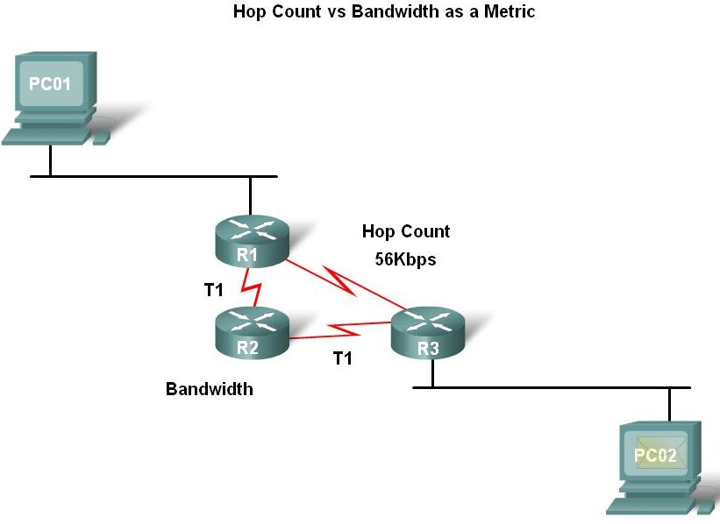
Router Paths and Packet Switching
A Metric is a numerical value used by routing protocols help determine the best path to a destination
The smaller the metric value the better the path
2 types of metrics used by routing protocols are:
Hop count - this is the number of routers a packet must travel through to get to its destination
Bandwidth - this is the “speed” of a link also known as the data capacity of a link

Slide 18
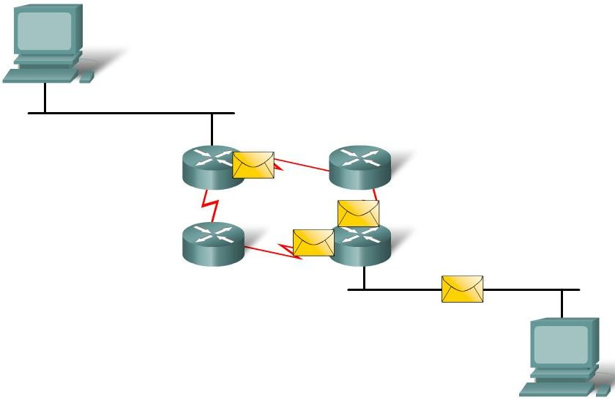
Router Paths and Packet Switching
Equal cost metric is a condition where a router has multiple paths to the same destination that all have the same metric
To solve this dilemma, a router will use Equal Cost Load Balancing - this means the router sends packets over the multiple exit interfaces listed in the routing table.

Slide 19
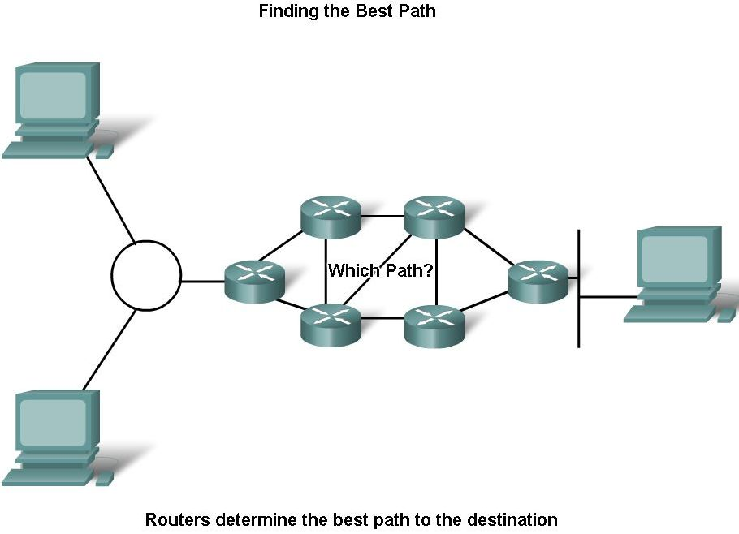
Router Paths and Packet Switching
Path determination is a process used by a router to pick the best path to a destination
One of 3 path determinations results from searching for the best path
Directly connected network
Remote network
No route determined

Slide 20
Router Paths and Packet Switching
Switching Function of Router is the process used by a router to switch a packet from an incoming interface to an outgoing interface on the same router
A packet received by a router will do the following:
Strips off layer 2 headers
Examines destination IP address located in Layer 3 header to find best route to destination
Re-encapsulates layer 3 packet into layer 2 frame
Forwards frame out exit interface

Slide 21
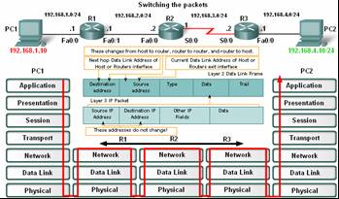
Router Paths and Packet Switching
As a packet travels from one networking device to another
The Source and Destination IP addresses NEVER change
The Source & Destination MAC addresses CHANGE as packet is forwarded from one router to the next
TTL field decrement by one until a value of zero is reached at which point router discards packet (prevents packets from endlessly traversing the network)

Slide 22
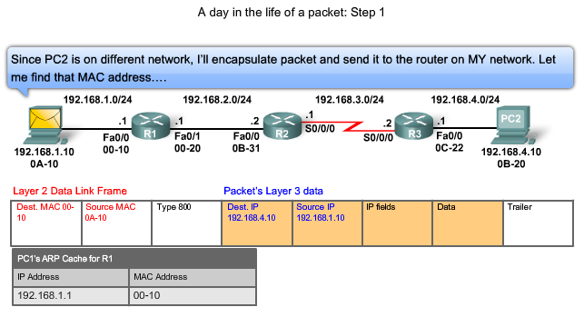
Router Paths and Packet Switching
Path determination and switching function details. PC1 wants to send something to PC 2.
Step 1 - PC1 encapsulates packet into a frame - frame contains R1’s destination MAC address

Slide 23
Router Paths and Packet Switching
Step 2 - R1 receives Ethernet frame
R1 sees that destination MAC address matches its own MAC
R1 then strips off Ethernet frame
R1 Examines destination IP
R1 consults routing table looking for destination IP
After finding destination IP in routing table, R1 now looks up next hop IP address
R1 re-encapsulates IP packet with a new Ethernet frame
R1 forwards Ethernet packet out Fa0/1 interface

Slide 24
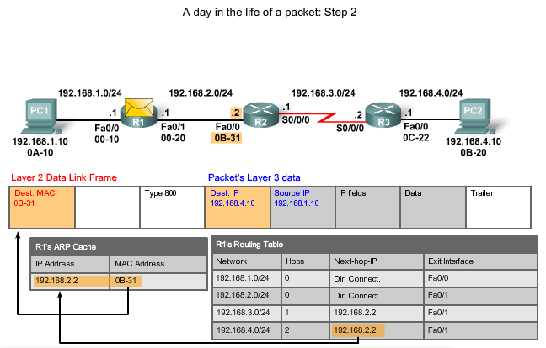
Router Paths and Packet Switching

Slide 25
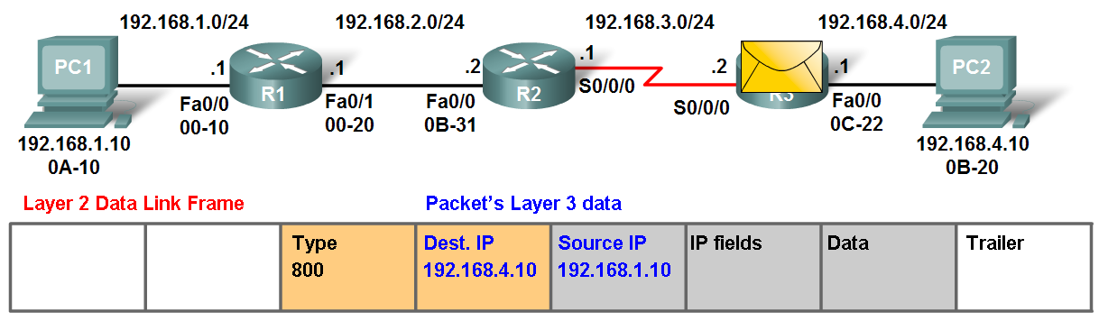
Router Paths and Packet Switching
Step 3 - Packet arrives at R2
R2 receives Ethernet frame
R2 sees that destination MAC address matches its own MAC
R2 then strips off Ethernet frame
R2 Examines destination IP
R2 consults routing table looking for destination IP
After finding destination IP in routing table, R2 now looks up next hop IP address
R2 re-encapsulates IP packet with a new data link frame
R2 forwards Ethernet packet out S0/0 interface

Slide 26
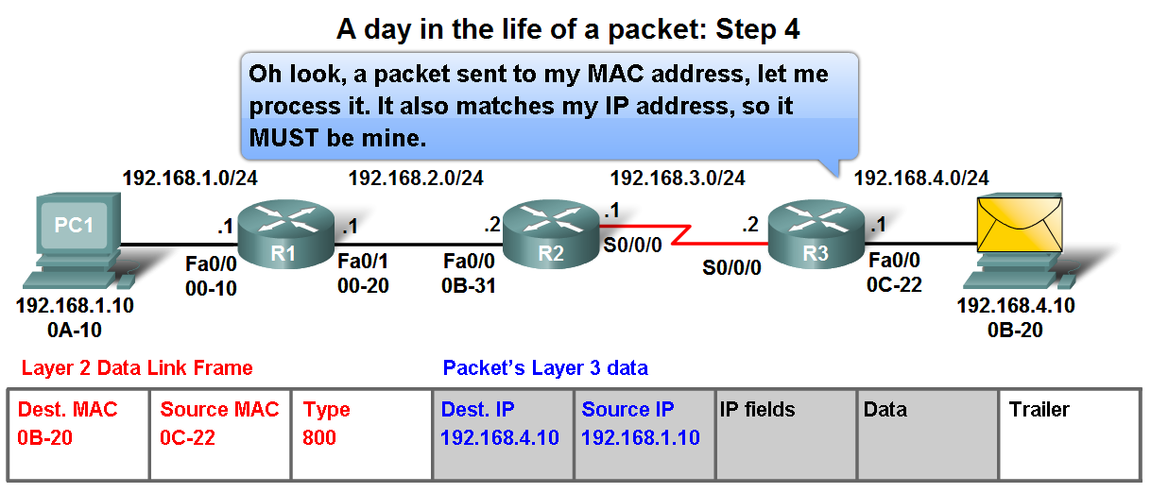
Router Paths and Packet Switching
Step 4 - Packet arrives at R3
R3 receives PPP frame
R3 then strips off PPP frame
R3 Examines destination IP
R3 consults routing table looking for destination IP
After finding destination IP in routing table, R3 is directly connected to destination via its fast Ethernet interface
R3 re-encapsulates IP packet with a new Ethernet frame
R3 forwards Ethernet packet out Fa0/0 interface
Step 5 - IP packet arrives at PC2 - frame is decapsulated and processed by upper layer protocols

Slide 27
Some Basic Routing Commands

Slide 28
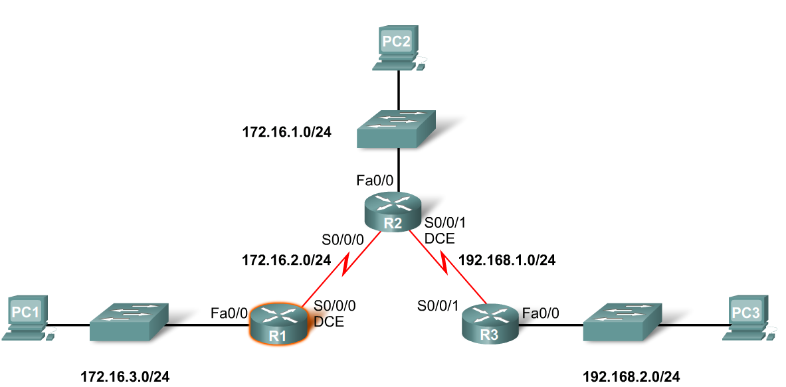
Interfaces
Examining Router Interfaces
Show IP router command – used to view routing table
Show Interfaces command – used to show status of an interface
Show IP Interface brief command – used to show a portion of the interface information
Show running-config command – used to show configuration file in RAM

Slide 29
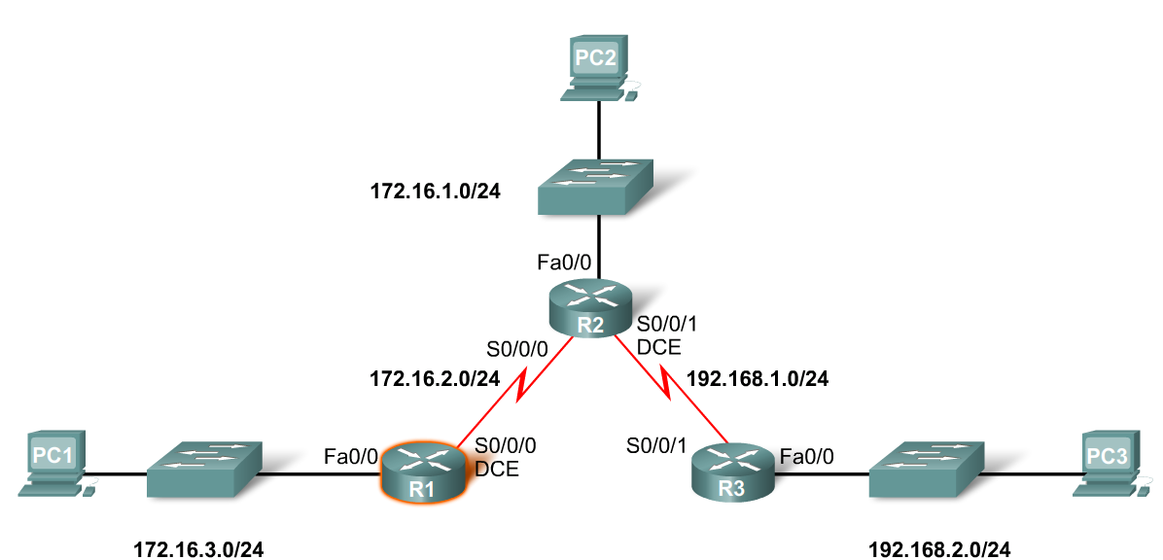
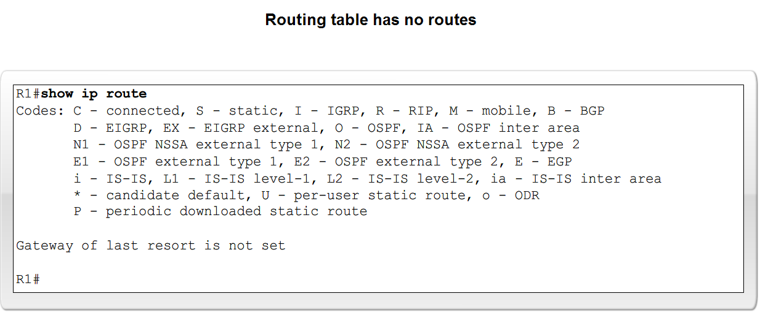
Interfaces
Configuring an Ethernet interface
By default all serial and Ethernet interfaces are down
To enable an interface use the No Shutdown command

Slide 30
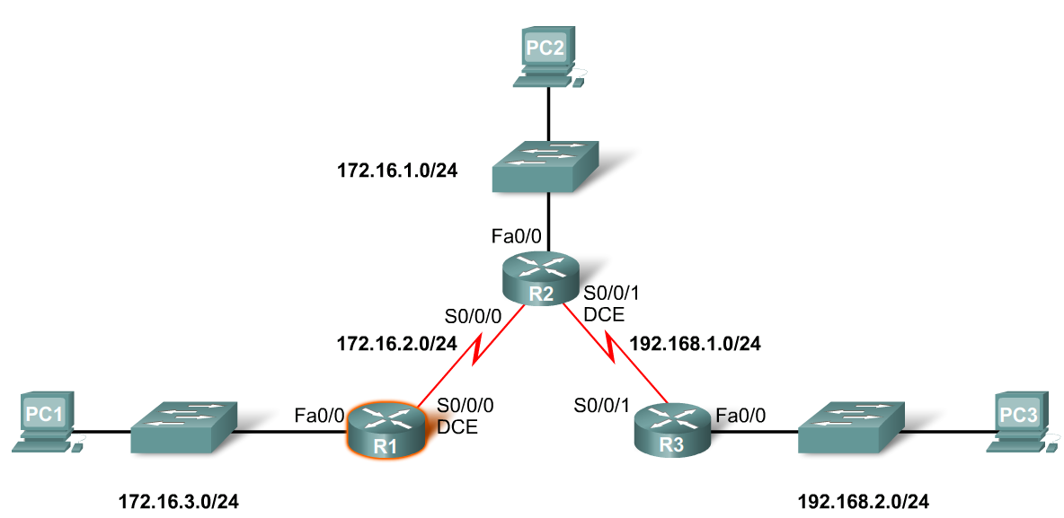
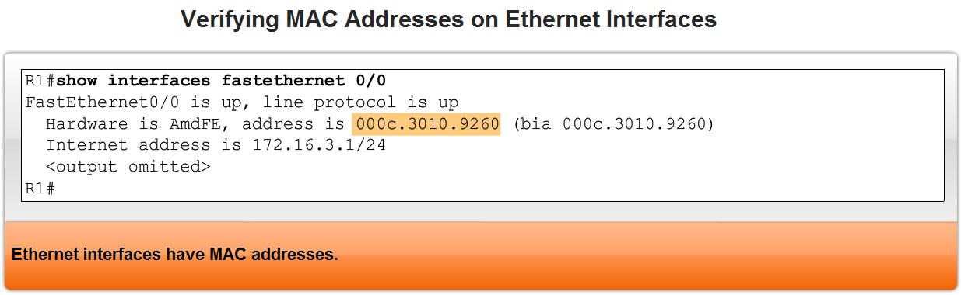
Interfaces
Verifying Ethernet interface
Show interfaces for fastEthernet 0/0 – command used to show status of fast Ethernet port
Show ip interface brief
Show running-config
Ethernet interfaces participate in ARP

Slide 31
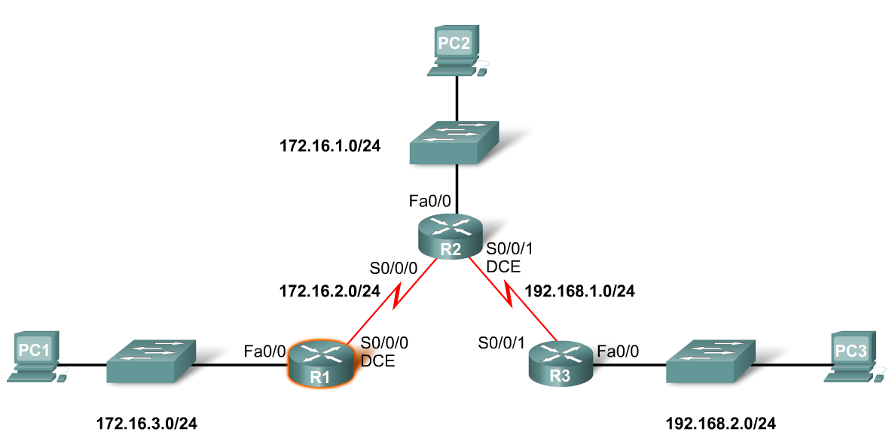
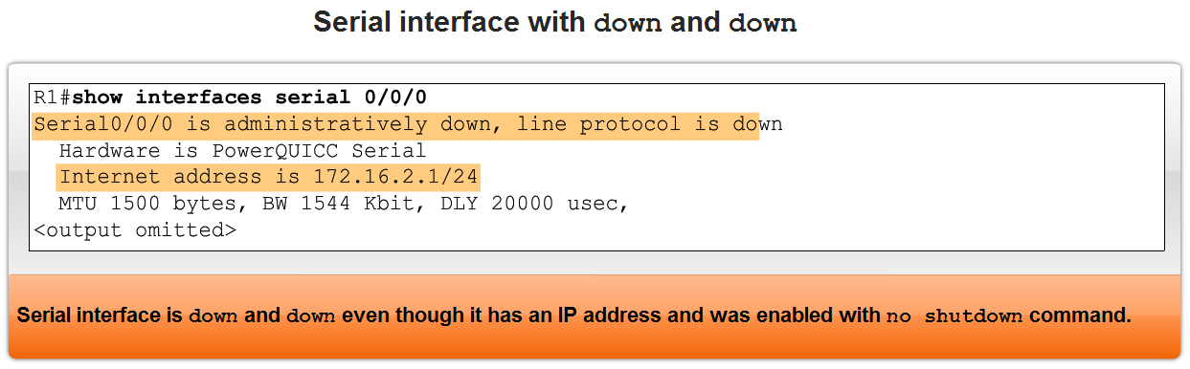
Interfaces
Configuring a Serial interface
Enter interface configuration mode
Enter in the ip address and subnet mask
Enter in the no shutdown command
Example:
R1(config)#interface serial 0/0
R1(config-if)#ip address 172.16.2.1 255.255.255.0
R1(config-if)#no shutdown

Slide 32
Interfaces
Configuring a Serial interface
Enter interface configuration mode
Enter in the ip address and subnet mask
Enter in the no shutdown command
Example:
R1(config)#interface serial 0/0
R1(config-if)#ip address 172.16.2.1 255.255.255.0
R1(config-if)#no shutdown

Slide 33
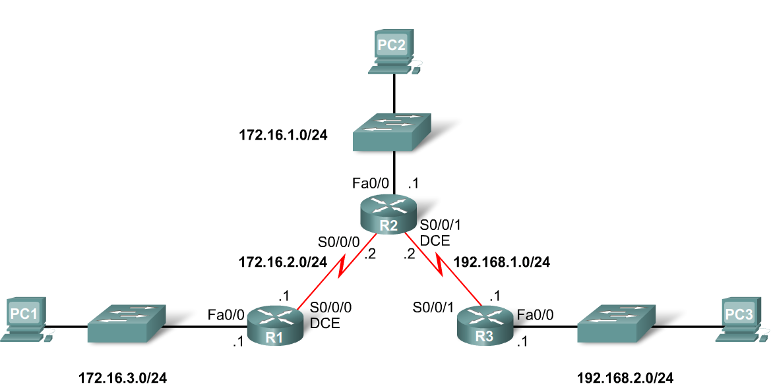
Routing Table and CDP Protocol
When a router only has its interfaces configured & no other routing protocols are configured then:
The routing table contains only the directly connected networks
Only devices on the directly connected networks are reachable

Slide 34
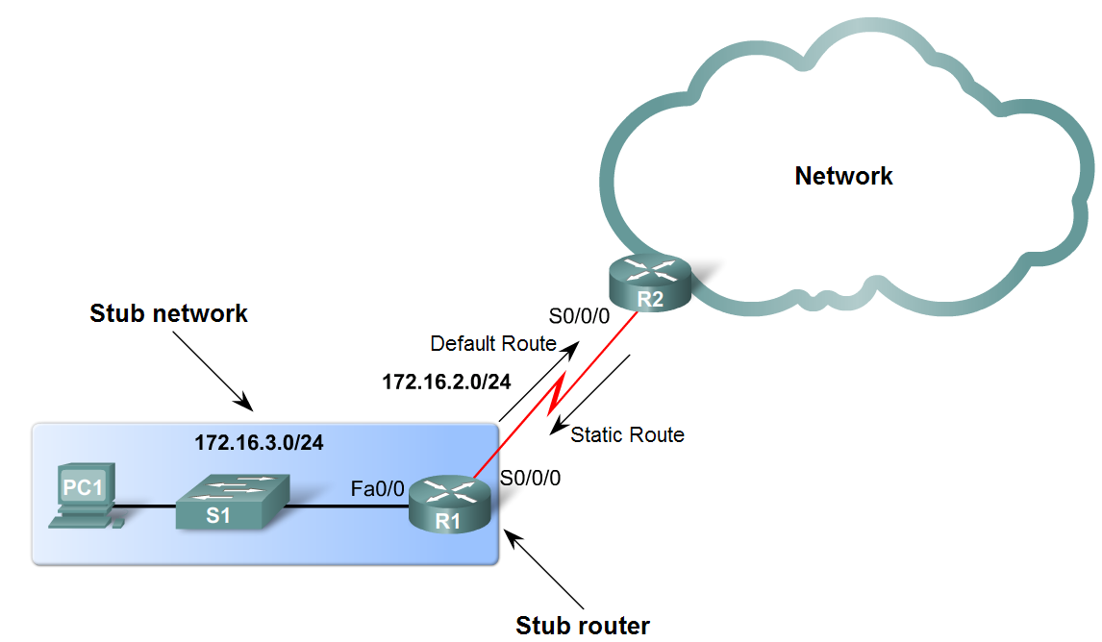
Static Routes with Exit Interfaces
Purpose of a static route
A manually configured route used when routing from a network to a stub network

Slide 35
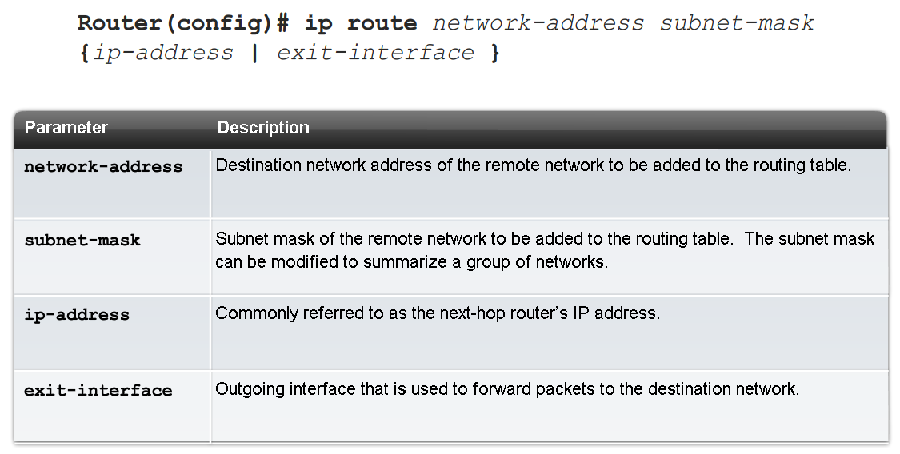
Static Routes with Exit Interfaces
IP route command
To configure a static route use the following command: ip route
Example:
Router(config)# ip route network-address subnet-mask {ip-address | exit-interface }

Slide 36

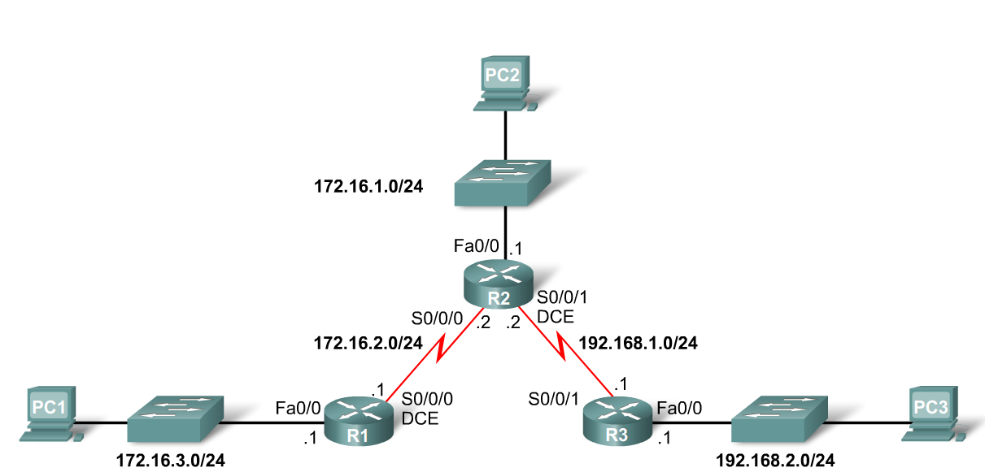
Static Routes with Exit Interfaces
Dissecting static route syntax
ip route - Static route command
172.16.1.0 – Destination network address
255.255.255.0 - Subnet mask of destination network
172.16.2.2 - Serial 0/0/0 interface IP address on R2, which is the "next-hop" to this network

Slide 37

Static Routes with Exit Interfaces
Configuring routes to 2 or more remote networks
Use the following commands for R1
R1(config)#ip route 192.168.1.0 255.255.255.0 172.16.2.2
R1(config)#ip route 192.168.2.0 255.255.255.0 172.16.2.2

Slide 38
Static Routes with Exit Interfaces
Zinin’s 3 routing principles
Principle 1: “Every router makes its decision alone, based on the information it has in its own routing table.”
Principle 2: “The fact that one router has certain information in its routing table does not mean that other routers have the same information.”
Principle 3: “Routing information about a path from one network to another does not provide routing information about the reverse, or return path.”

Slide 39
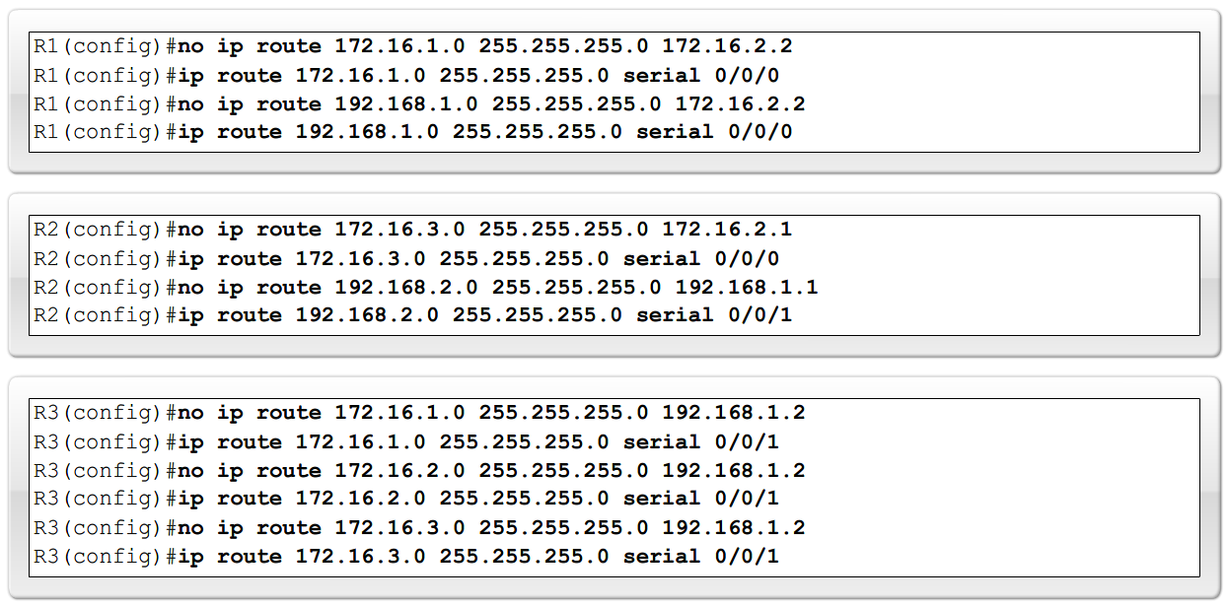
Static Routes with Exit Interfaces
Modifying Static routes
Existing static routes cannot be modified. The old static route must be deleted by placing no in front of the ip route
Example:
no ip route 192.168.2.0 255.255.255.0 172.16.2.2
A new static route must be rewritten in the configuration

Slide 40
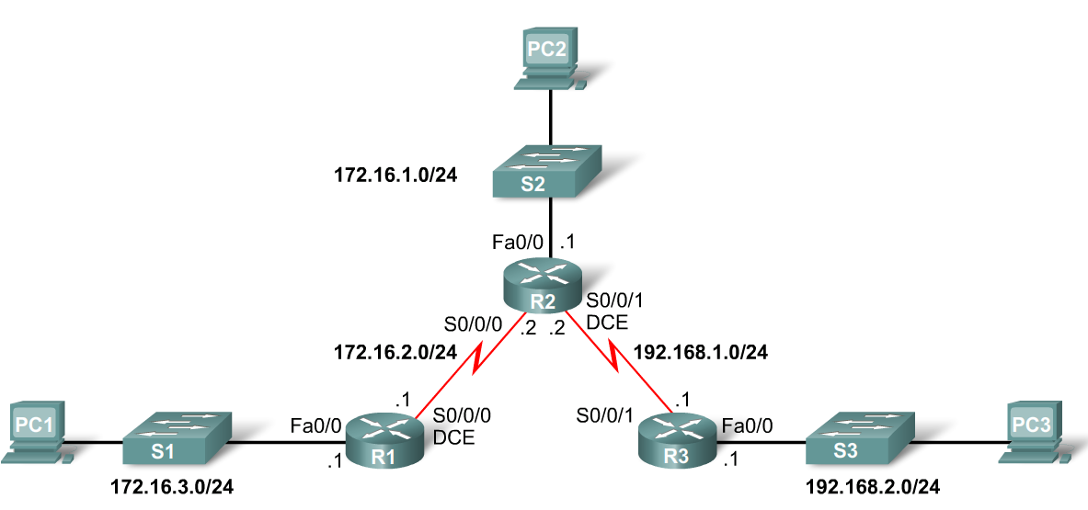
Static Routes with Exit Interfaces
Verifying the Static Route Configuration
Use the following commands
Step 1 show running-config
Step 2 verify static route has been entered correctly
Step 3 show ip route
Step 4 verify route was configured in routing table
Step 5 issue ping command to verify packets can reach destination and that Return path is working

Slide 41
Default Route
Default Static Route
This is a route that will match all packets. Stub routers that have a number of static routes all exiting the same interface are good candidates for a default route.
Like route summarization this will help reduce the size of the routing table.
Configuring a default static route
Similar to configuring a static route. Except that destination IP address and subnet mask are all zeros.
Example:
Router(config)#ip route 0.0.0.0 0.0.0.0 [exit-interface | ip-address ].

Slide 42
Default Route
Static routes and subnet masks
The routing table lookup process will use the most specific match when comparing destination IP address and subnet mask
Default static routes and subnet masks
Since the subnet mask used on a default static route is 0.0.0.0 all packets will match

Slide 43
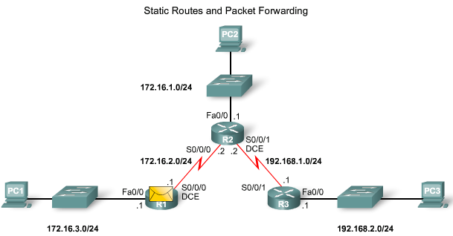
Static Routes and Packet Forwarding
Packet forwarding with static routes (recall Zinin’s 3 routing principles)
Router 1
Packet arrives on R1’s Fastethernet 0/0 interface
R1 does not have a route to the destination network, 192.168.2.0/24
R1 uses the default static route

Slide 44
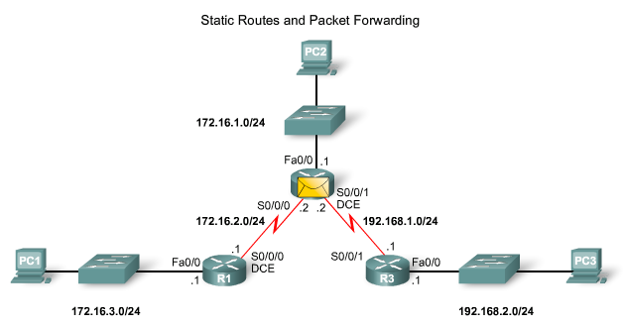
Static Routes and Packet Forwarding
Packet forwarding with static routes (recall Zinin’s 3 routing principles)
Router 2
The packet arrives on the Serial 0/0/0 interface on R2
R2 has a static route to 192.168.2.0/24 out Serial0/0/1

Slide 45
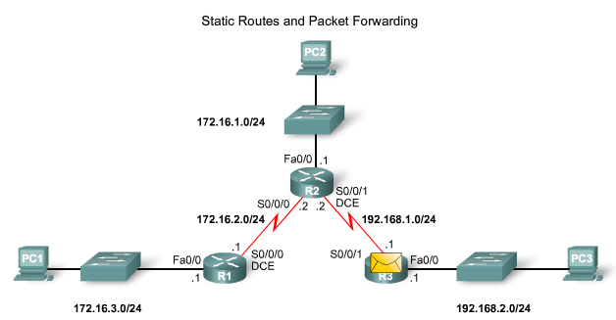
Static Routes and Packet Forwarding
Packet forwarding with static routes. (recall Zinin’s 3 routing principles)
Router 3
The packet arrives on the Serial0/0/1 interface on R3
R3 has a connected route to 192.168.2.0/24 out Fastethernet 0/1

Slide 46
Static Routes and Packet Forwarding
Troubleshooting a Missing Route
Tools that can be used to isolate routing problems include:
Ping - tests end to end connectivity
Traceroute - used to discover all of the hops (routers) along the path between 2 points
Show IP route - used to display routing table & ascertain forwarding process
Show ip interface brief - used to show status of router interfaces
Show cdp neighbors detail - used to gather configuration information about directly connected neighbors

Slide 47
Static Routes and Packet Forwarding
Solving a Missing Route
Finding a missing or mis-configured route requires methodically using the correct tools
Start with PING - if ping fails then use traceroute to determine where packets are failing to arrive
Issue: show ip route to examine routing table
If there is a problem with a mis-configured static route remove the static route then reconfigure the new static route

Slide 48
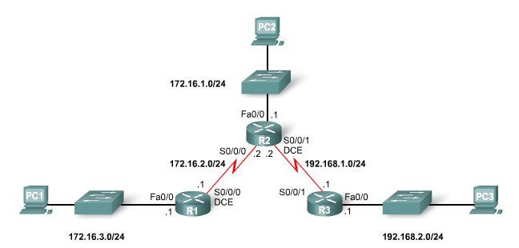
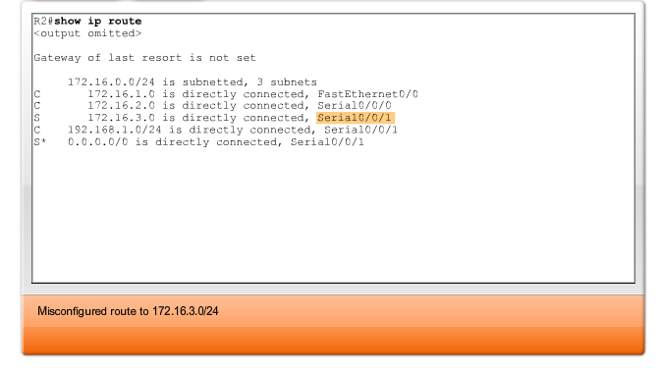
Static Routes and Packet Forwarding
Solving a Missing Route

